Slide 1
Abstract Syntax Tree
Ayush Sawlani (IMT2018014)
Manan Bansal (IMT2018039)
Soham Kolhe (IMT2018073)

Slide 2
Introduction
An abstract syntax tree (AST) is a tree that is used to represent abstract syntactic structure of the source code written in a programming language.
AST is usually the result of the syntax analysis phase of a compiler.
The AST is used intensively during semantic analysis, where the compiler checks for correct usage of the elements of the program and the language

Slide 3
Lexical Analysis aka Tokenization
Lexical analysis is the first phase of a compiler.
During this step, the code is going to be converted into a set of tokens describing the different parts of the code.
Tokens purely focus on components of a file.
Keywords, constants, identifiers, strings, numbers, operators and punctuations symbols can be considered as tokens.

Slide 4
Syntax Analysis aka Parsing
A syntax analyzer or parser takes the input from a lexical analyzer in the form of token streams.
The parser analyzes the source code (token stream) against the production rules to detect any errors in the code.
This is the step where the list of tokens are turned into an Abstract Syntax Tree.
It converts all the tokens into a tree that represents the actual structure of the code.

Slide 5

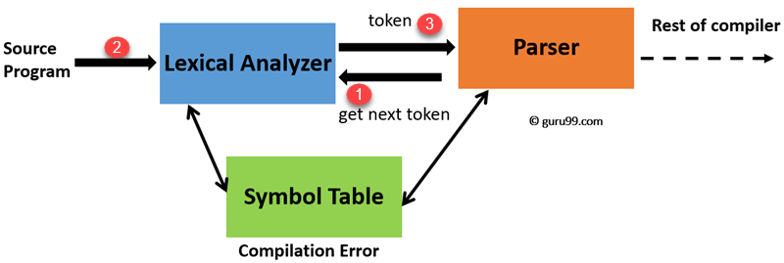

Slide 6
Implementation

Slide 7
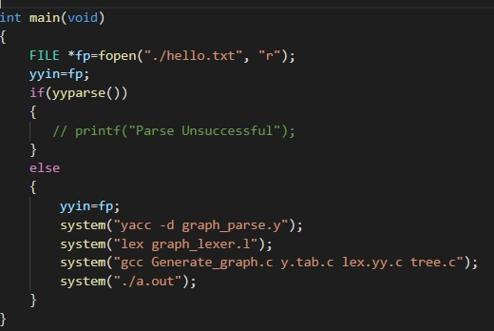
Starting Code
Checking the input string of code with the initial lexer and parser files
Calling the main lexer and parser files if initial parsing is successful.

Slide 8
Yacc and lex
Lex is a lexical analyzer generator program that recognizes tokens using regular expression.
Yacc is a parser generator program that takes as input a specification of a syntax and produces as output a procedure for recognizing that language.

Slide 9
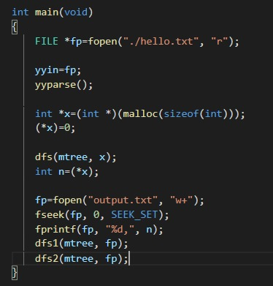
Tree Generation
Graph Generated.
Output stored in output.txt.
The output is then visualised using THREE.js library in JavaScript

Slide 10
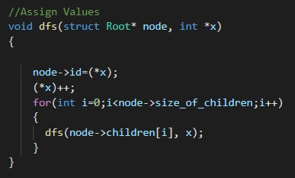
Assigning value
Assigning Value.
Calculating total nodes.

Slide 11
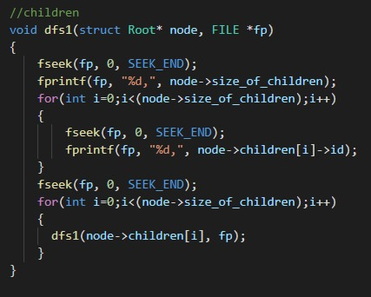
Saving Tree
Tree saved in output.txt
Number of Children then children ID

Slide 12
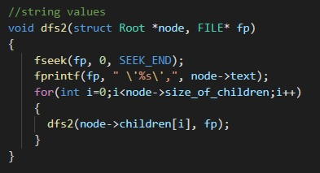
Saving Tree
Value of tokens saved in output.txt

Slide 13

Tree Visualization

Slide 14
GitHub
https://github.com/sohamk990/PL-Project-C-3D-AST-Visualization

Slide 15
THANK YOU

